Slide 1
ClockDreams

Slide 2
ClockHistory

Slide 4
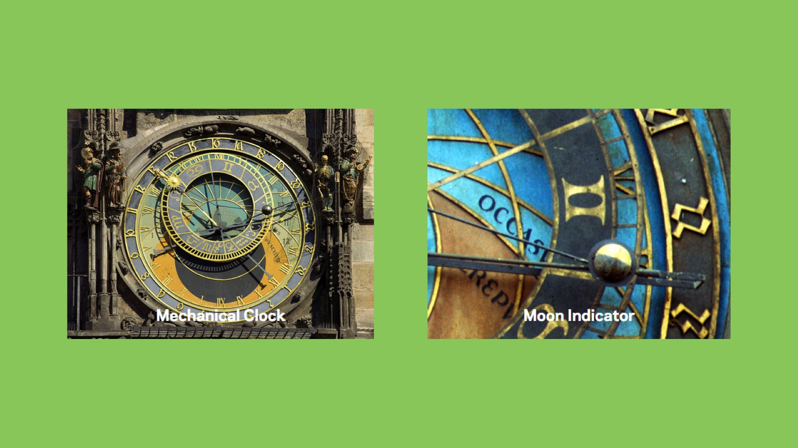

Slide 6
These got built when?

Slide 7
These got built when?

Slide 10
How Clocks Function

Slide 11
A video will now play.

Slide 12
ClockSamples

Slide 14
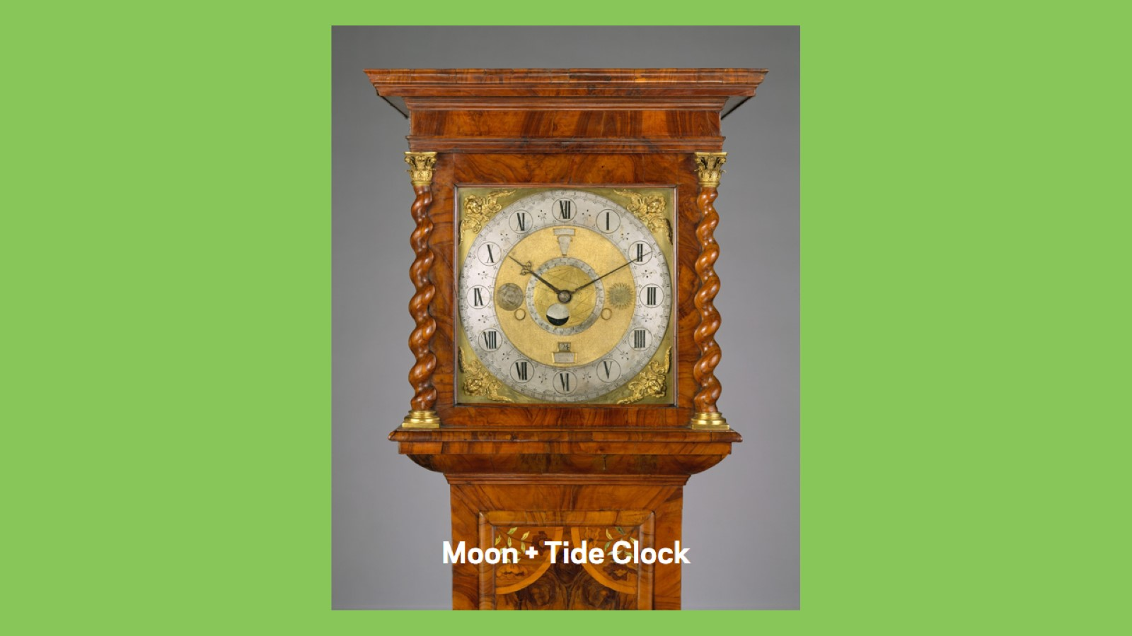

Slide 17
Clock Or Not

Slide 18
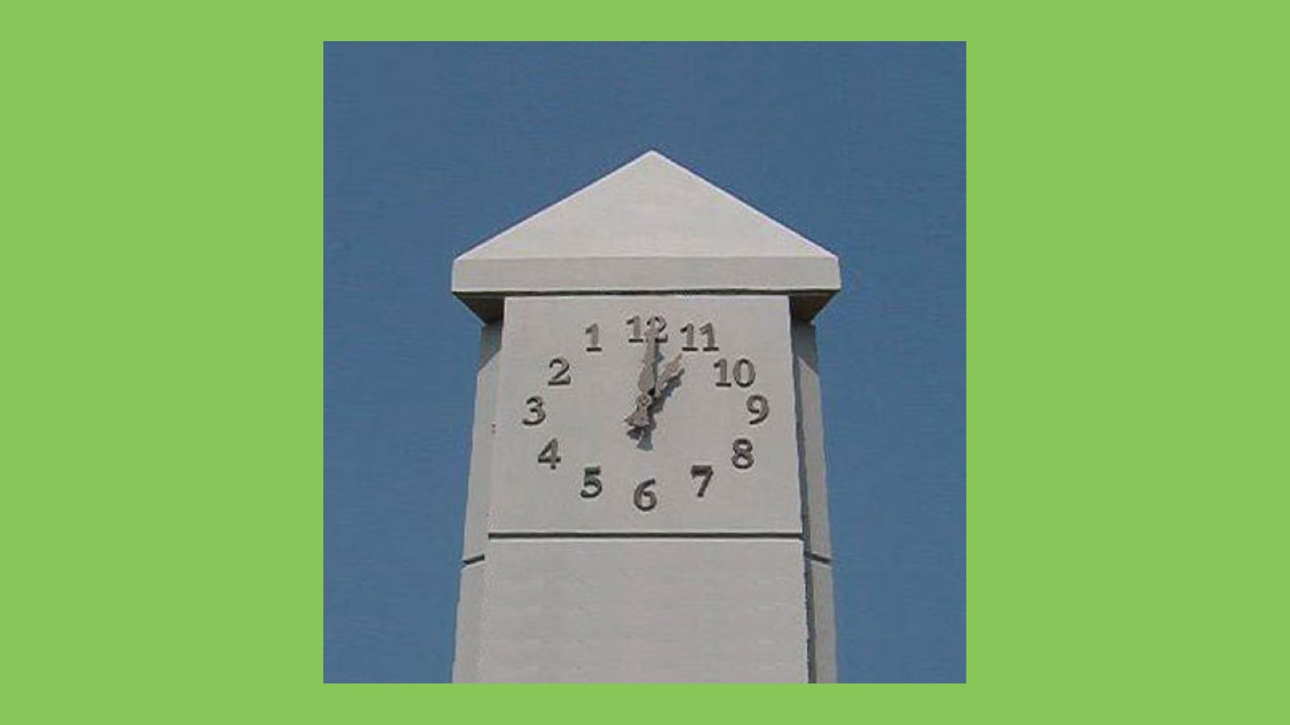

Slide 19
Yes. Concrete Electrical Clock

Slide 20
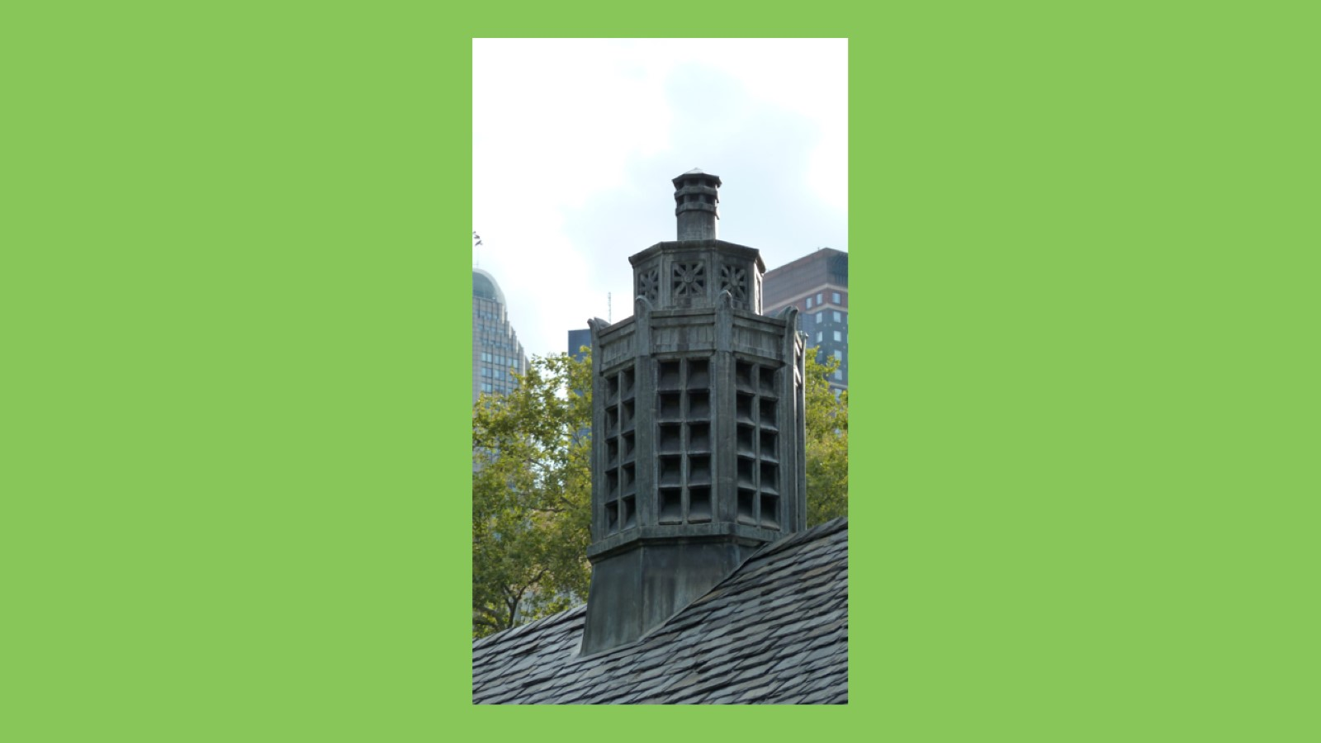

Slide 21
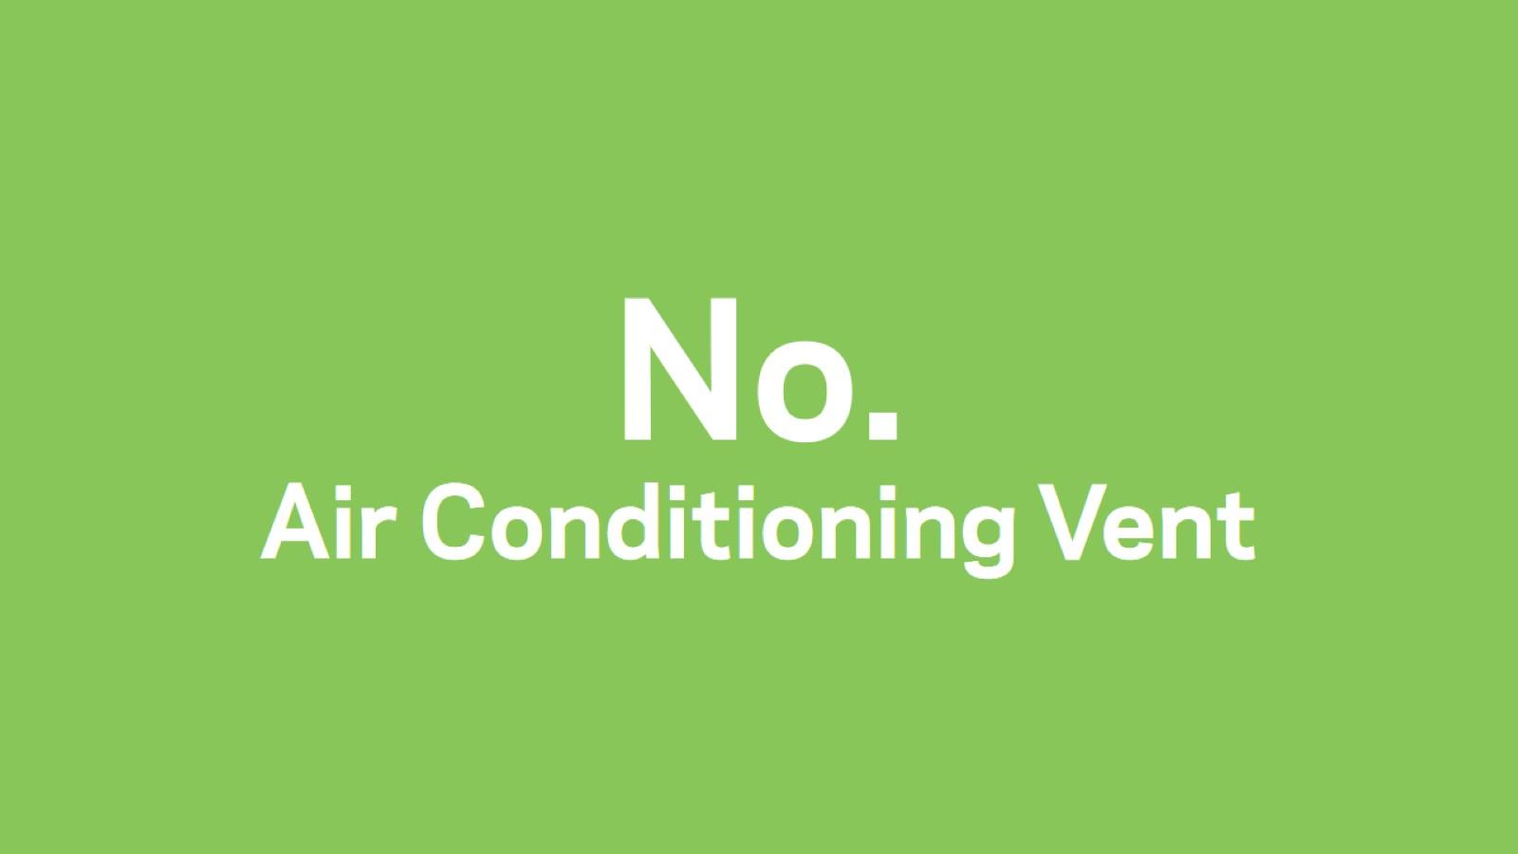
No. Air Conditioning Vent

Slide 22
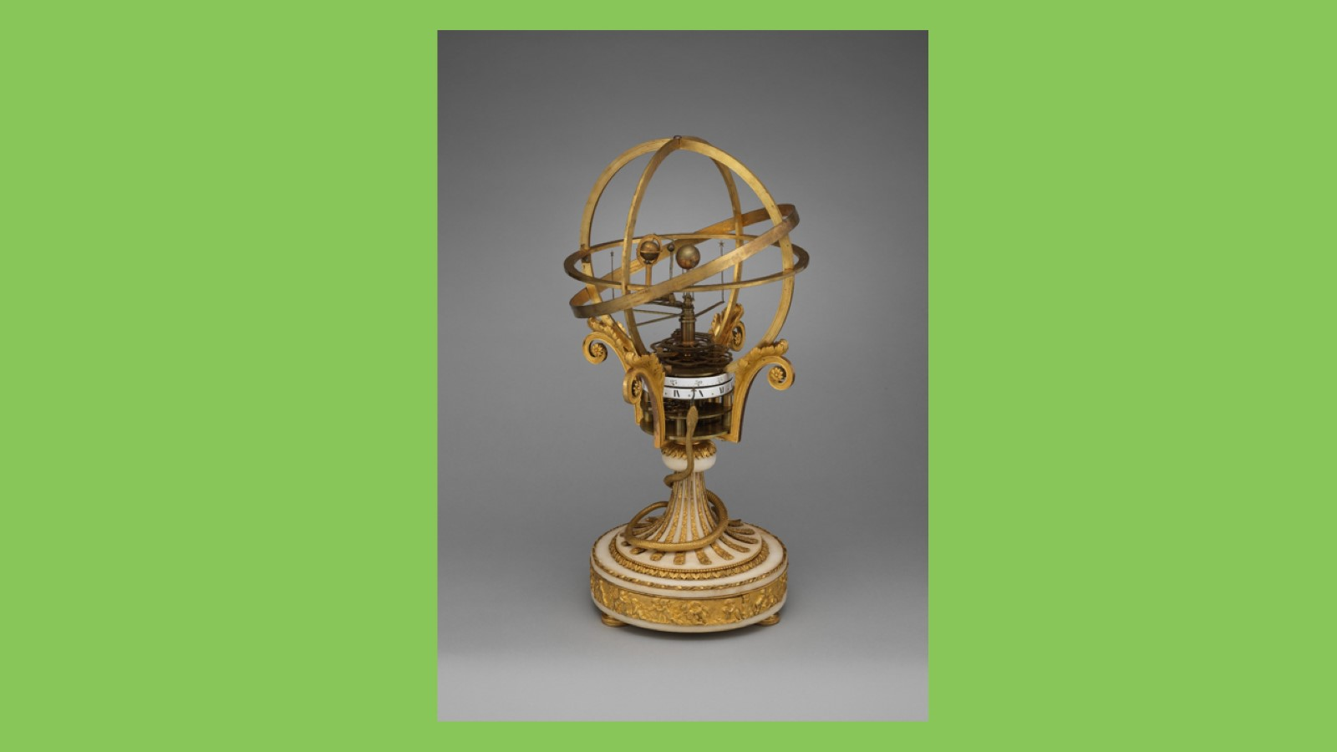

Slide 23
Yes. Solar System Clock

Slide 25
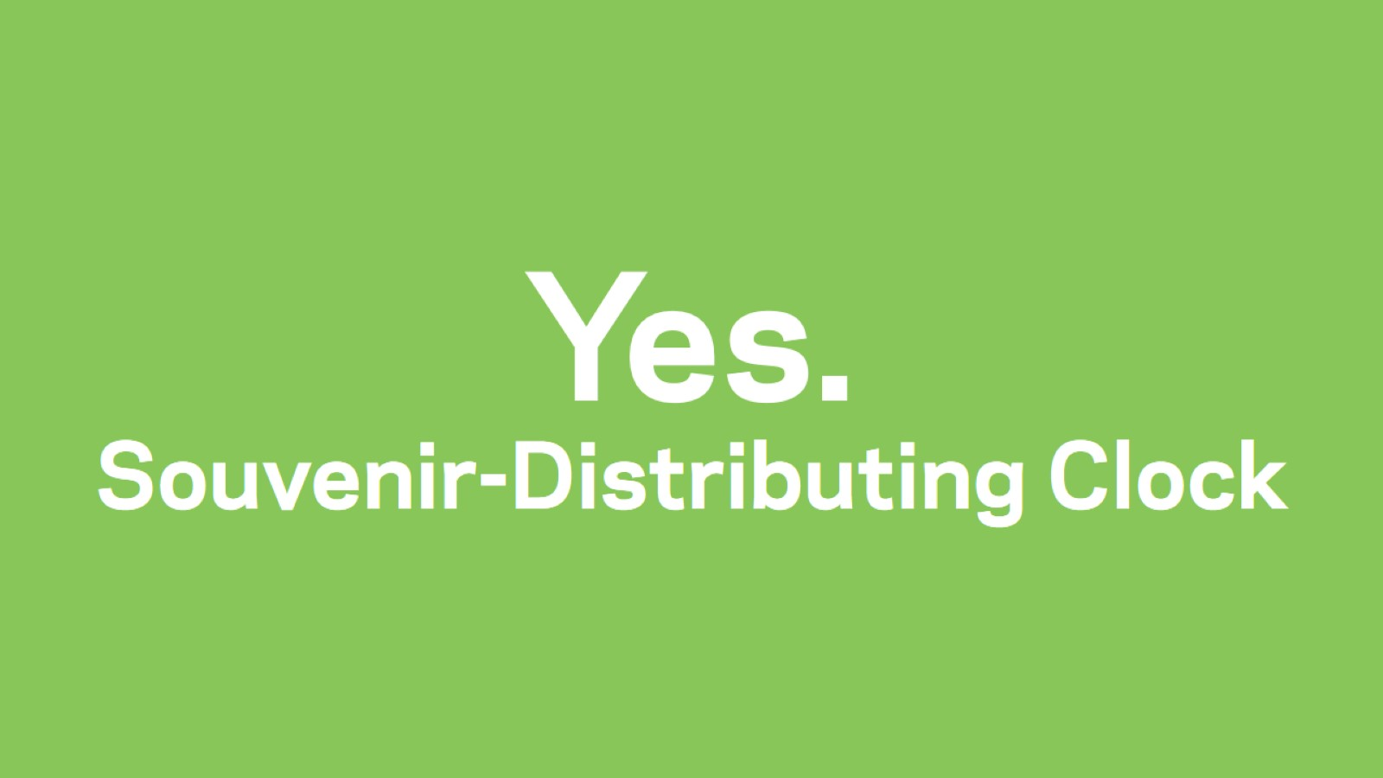
Yes. Souvenir-Distributing Clock

Slide 26
ClockFacts

Slide 29
Activity

Slide 30
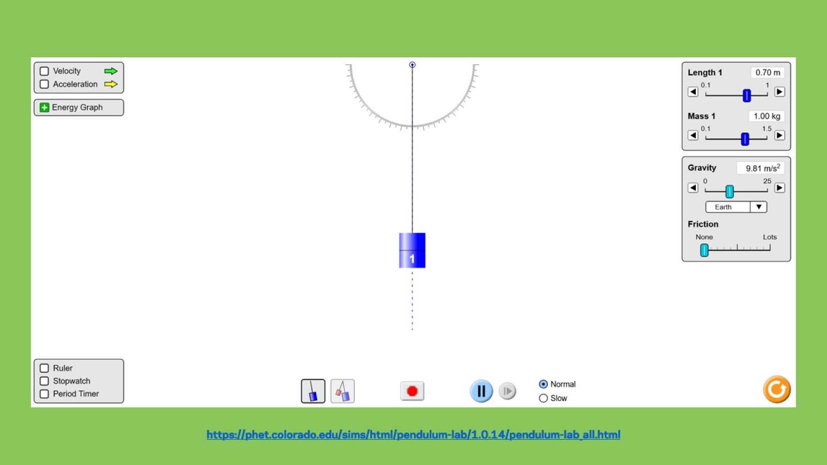

Slide 31
The End

